Slide 1
In the Beginning…

Slide 2
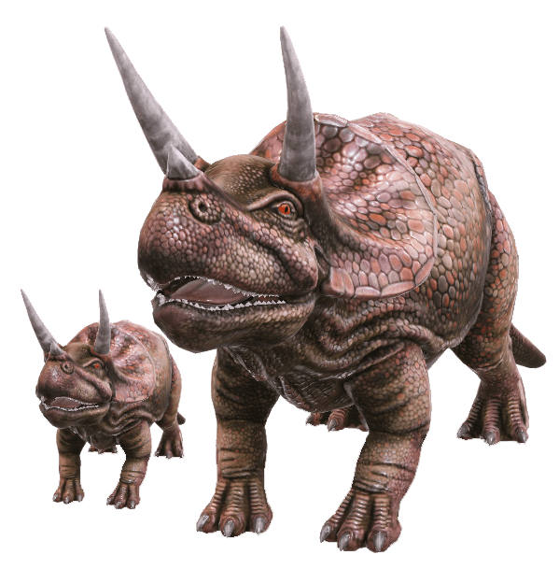
There were dinosaurs

Slide 3
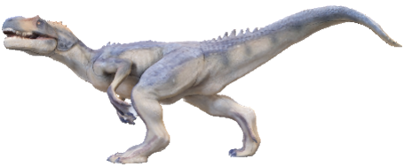
Timeline
Triceratops roamed the Earth during the latter half of the Cretaceous period, around 65-72 million years ago.
Allosaurus
Triceratops
Triassic Period
Jurassic Period
Cretaceous Period
150
245
200
145
65
The Cretaceous ended with the most famous mass extinction in all of history; the Cretaceous-Tertiary.
Triceratops was one of the last dinosaurs to become extinct.
Mind blowing fact!
More time exists between Allosaurus in the Jurassic Period and Triceratops in the Cretaceous (83 million years) than between Triceratops and humans.

Slide 4
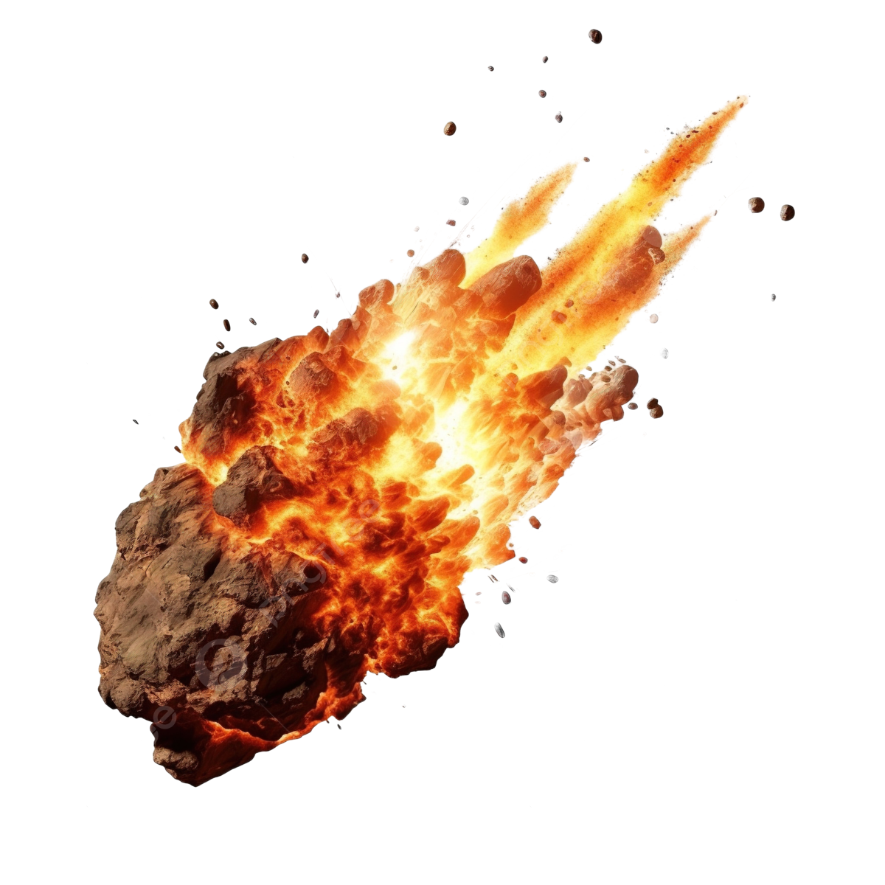
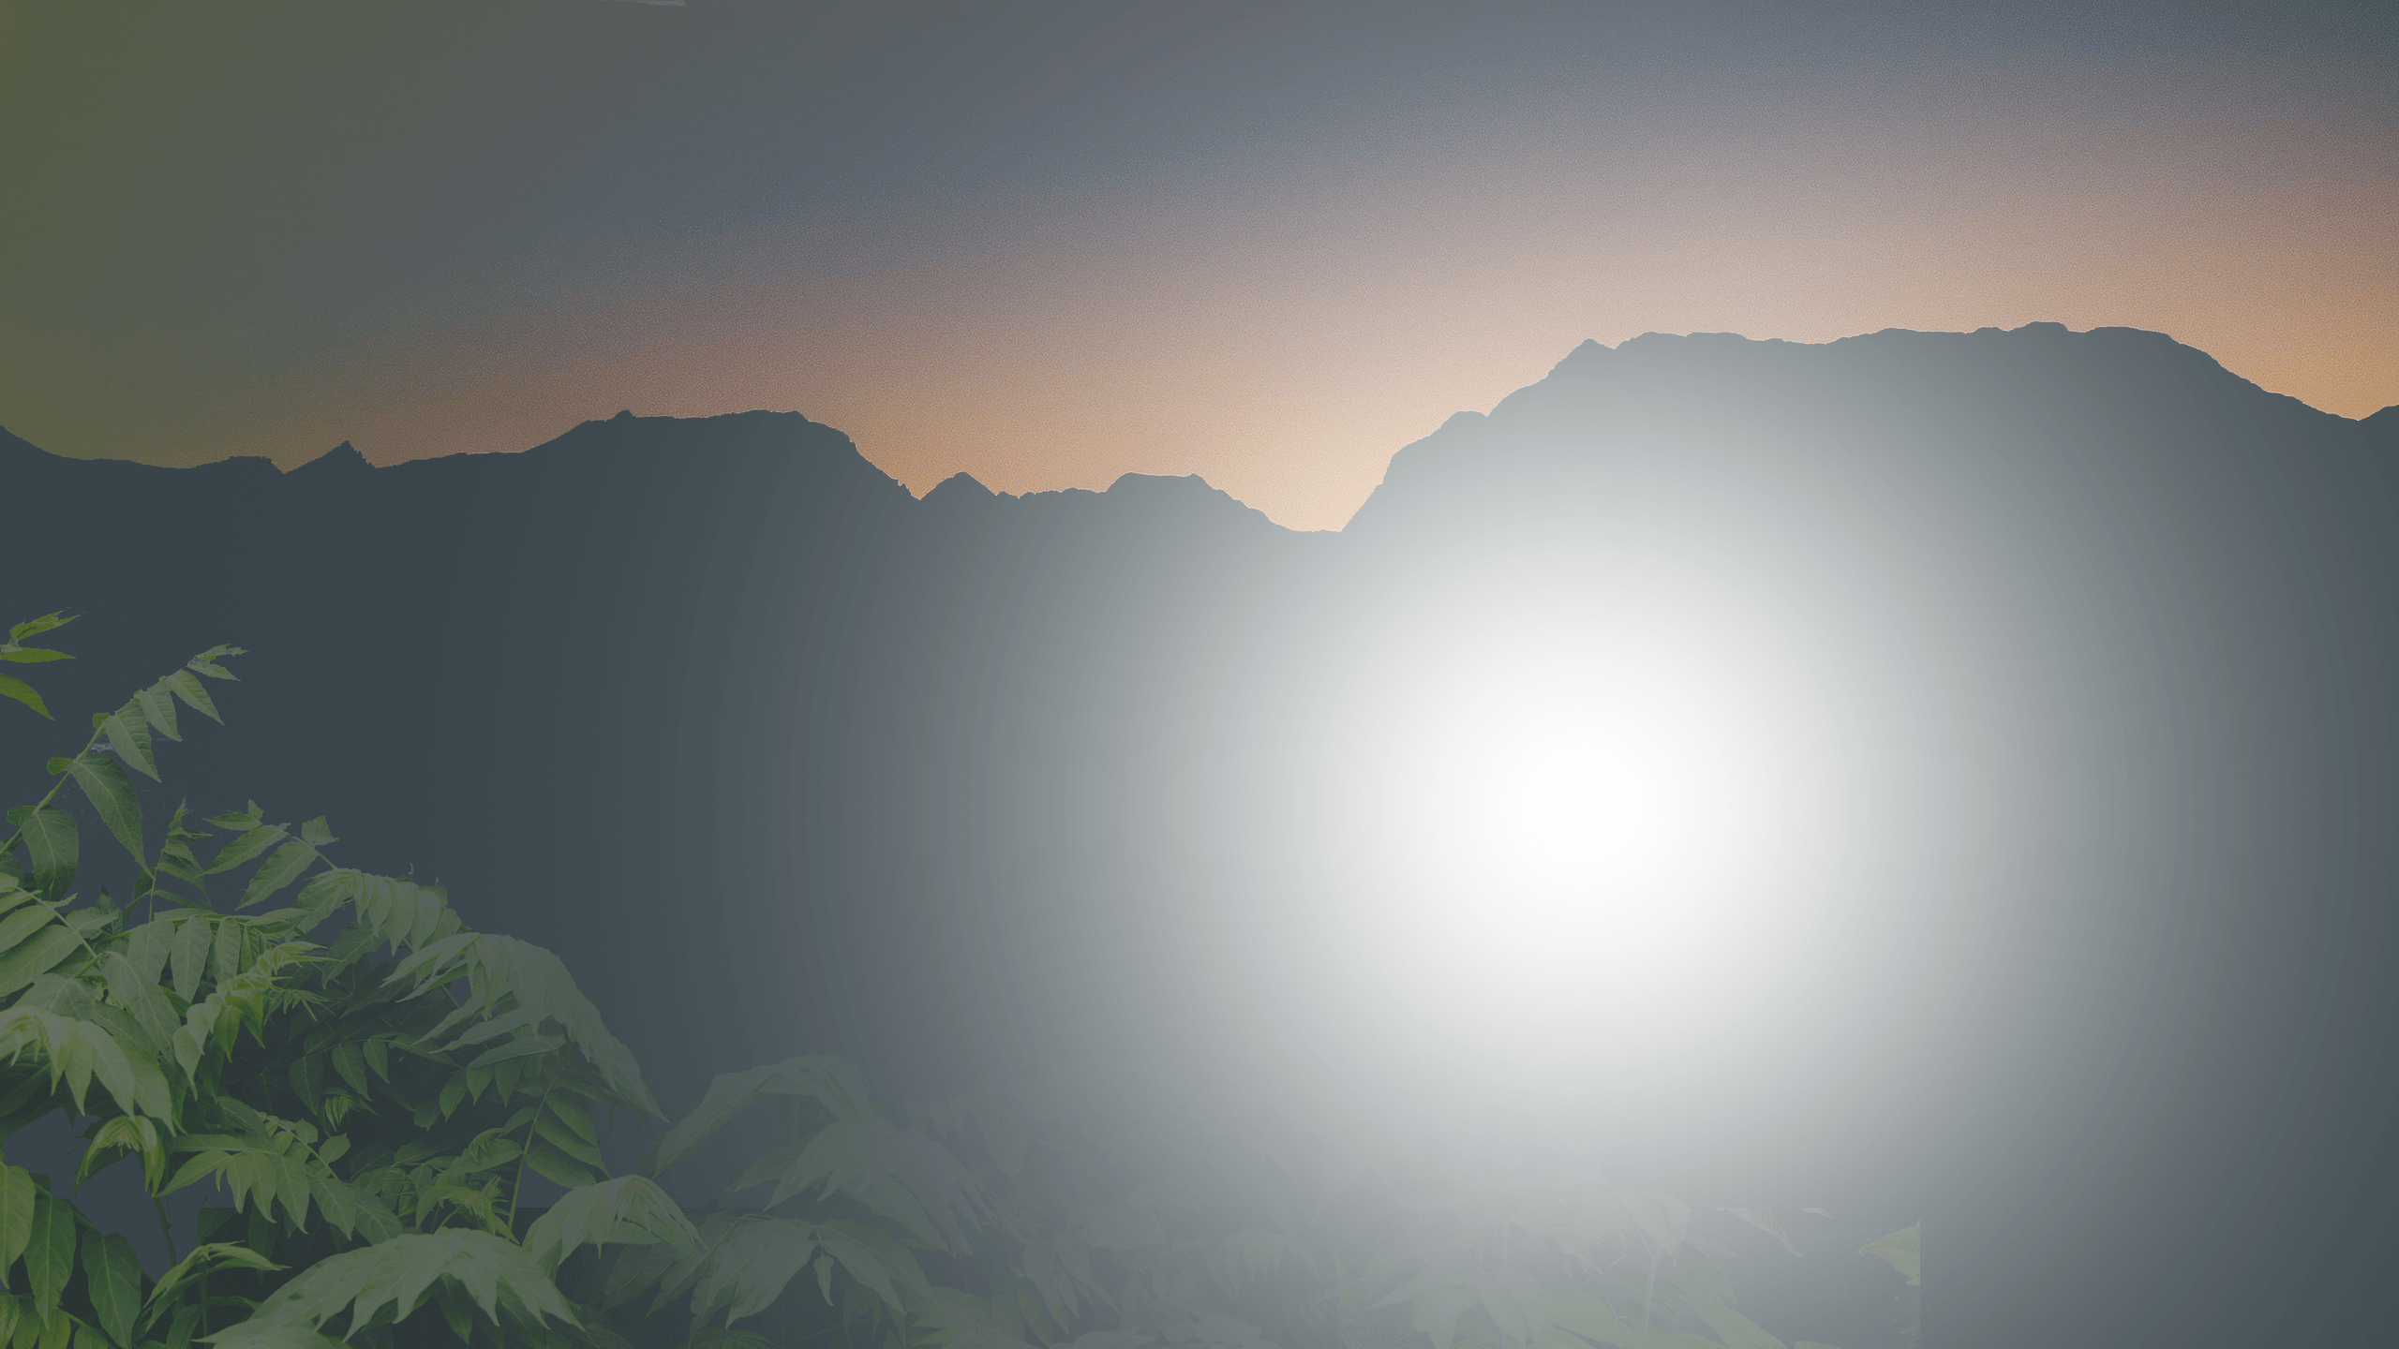
Triceratops means literally, “three horned face”
Two horns
just above the eyes and a smaller one on the snout.
The third horn
was a ‘false’ horn made of soft protein. Scientists are still unsure as to its purpose.

Slide 5
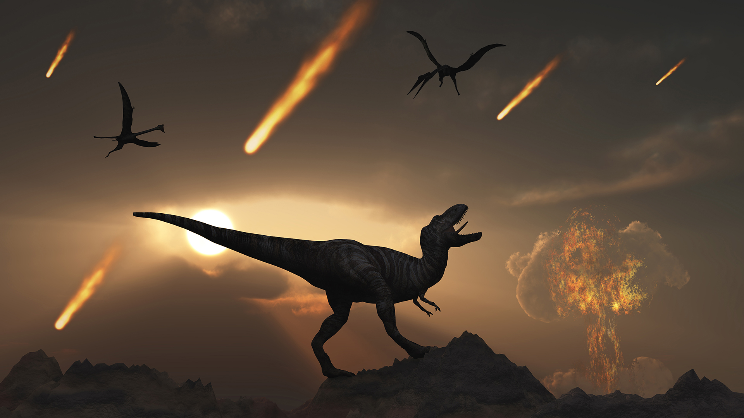

Slide 6
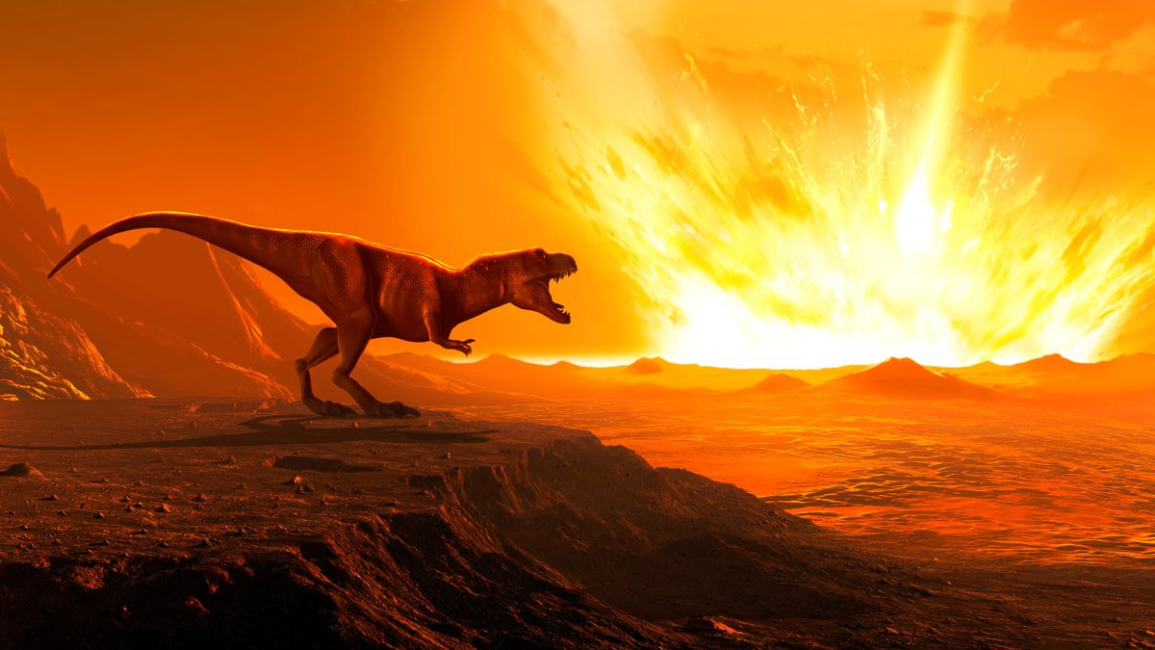

Slide 7
Can we predict this year event happening again?
Mathematically, yes!
Extreme Value Theory in Dynamical Systems

Slide 30
Thankyou

